Slide 1






D.Y PATIL COLLEGE OF ENGINEERING & TECHNOLOGY
Title: Student Result Management System using C++
Subtitle: A C++ Based Application for Efficient Student Record Management.
Presented by:
Roll.No | Names
81 | Mrinal Patole
83 | Reeya Jadhav
95 | Shivam Patil
97 | Pranav Patil

Slide 2
CONTENTS
1. Title Slide
2. Introduction
3. Problem Statement & Objectives
4. System Design
5. Description of Modules
6. Software & Hardware Requirements
7. Result Analysis
8. Comparison of Proposed System with Existing System
9. Conclusion
10. Future Scope
11. References

Slide 3





INTRODUCTION
Student Management System To Manage Student Records.
Functions To Add, View, And Delete Records.
Uses C++ And File Handling For Storing Data.

Slide 4
INTRODUCTION
Existing System with Drawbacks:
Current systems often require complex setup and maintenance.
Requires databases or servers, making it harder for small institutions.
Why This Project?
Offers a simpler solution with file-based storage.
Easy to use and maintain, ideal for small institutions.

Slide 5


PROBLEM STATEMENT:
Schools use manual methods for student records, which is inefficient.
Current systems are too complex for small schools.

Slide 6
OBJECTIVES
Create a simple system for managing student records.
Allow users to add, view, and delete records.
Automatically calculate total marks, percentage, and grade.
Store data in text files for easy access.

Slide 7
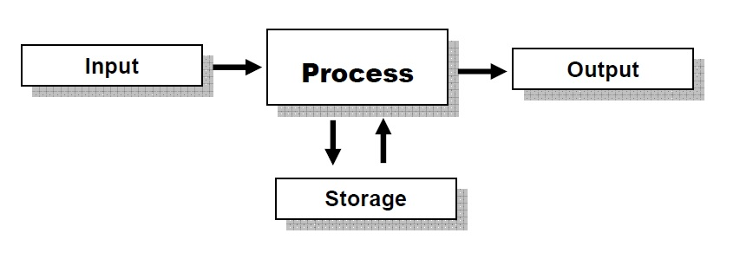
SYSTEM DESIGN
Input: Student details (name, roll number, marks).
Processing: Calculate total, percentage, assign grades.
Output: Display records and save in a text file.

Slide 8

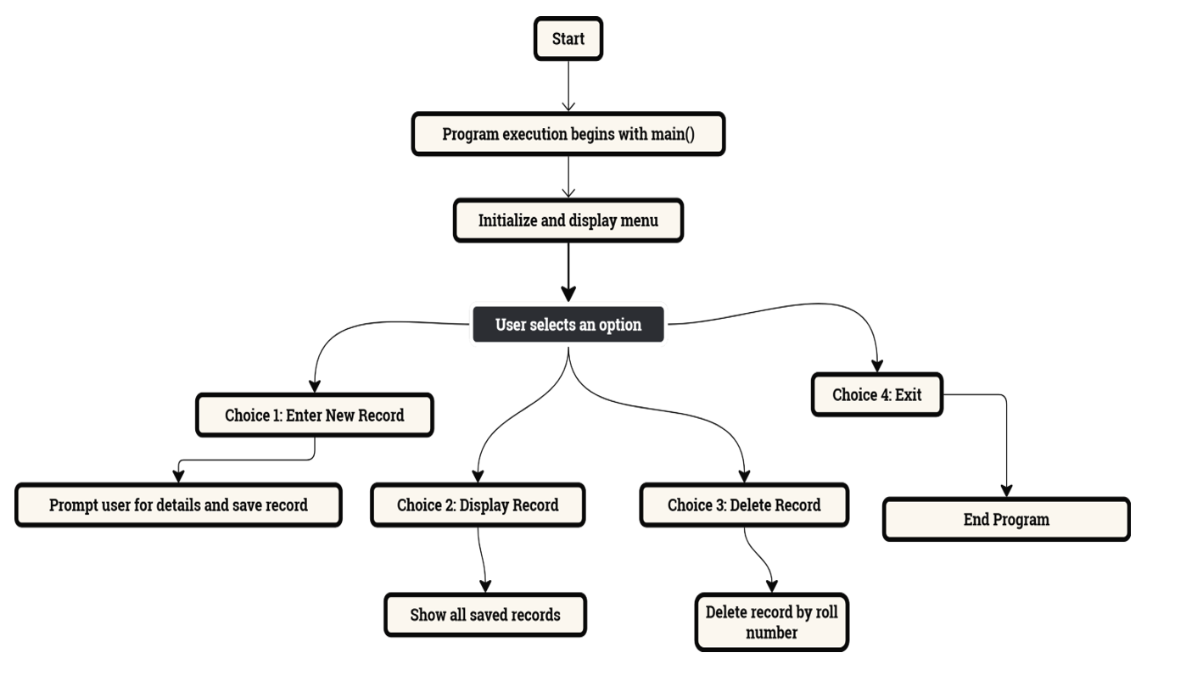
FLOWCHART

Slide 9
Description of Modules
Insert Module:
Display Module:
Delete Module:
Input: Student details and marks.
Processing: Calculate total marks and percentage, assign grades.
Output: Save data to studentresult.txt.
Input: Roll number of student to delete.
Processing: Search for the student and delete if found.
Output: Display success or failure message.
Input: None (reads from file).
Processing: Reads and displays student records.
Output: Display student records on the screen.

Slide 10



SOFTWARE & HARDWARE REQUIREMENTS
Hardware Requirements:
Computer: Any PC or laptop (Windows/Linux).
Input/Output Devices: Keyboard and monitor.
Software Requirements:
C++ Compiler (MinGW, GCC).
IDE/Text Editor (Code::Blocks, Dev-C++).

Slide 11
LIBRARIES USED:
fstream:: For reading and writing student data to files.
Used: To store student records permanently.
cstdlib: For system commands like clearing screen and exiting program.
Used: To manage user interface.

Slide 12
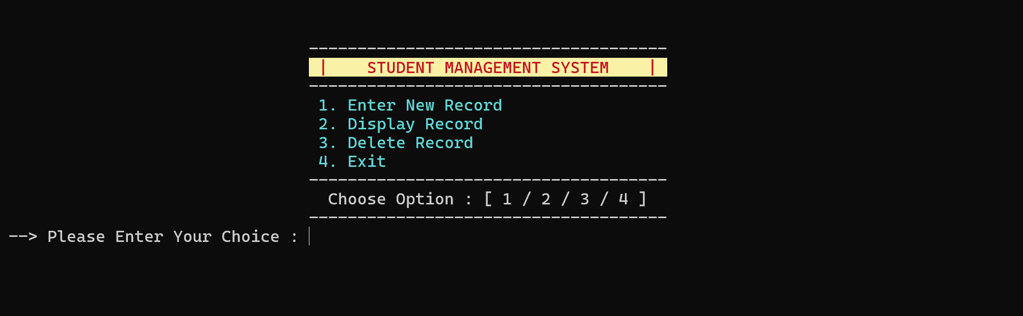
RESULT ANALYSIS
Menu function

Slide 13
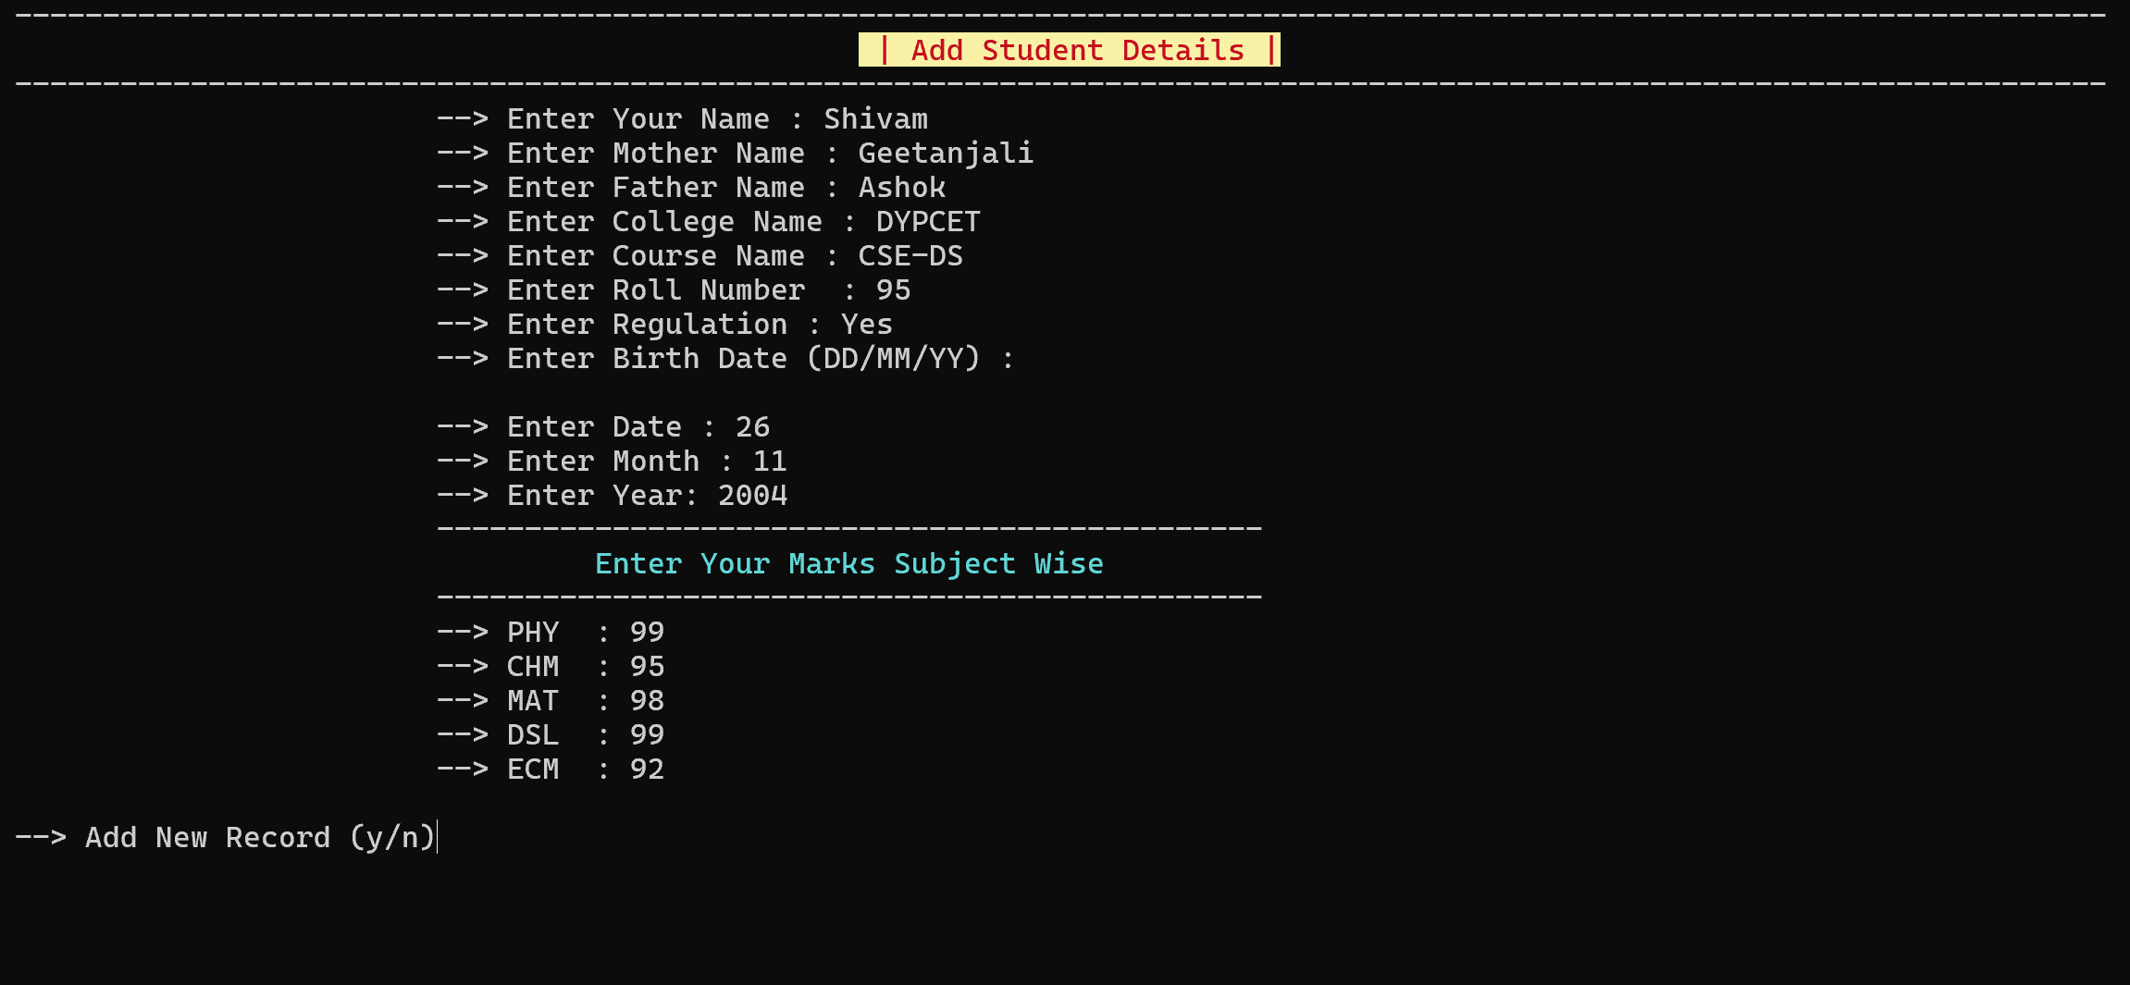
Adding a new record

Slide 14
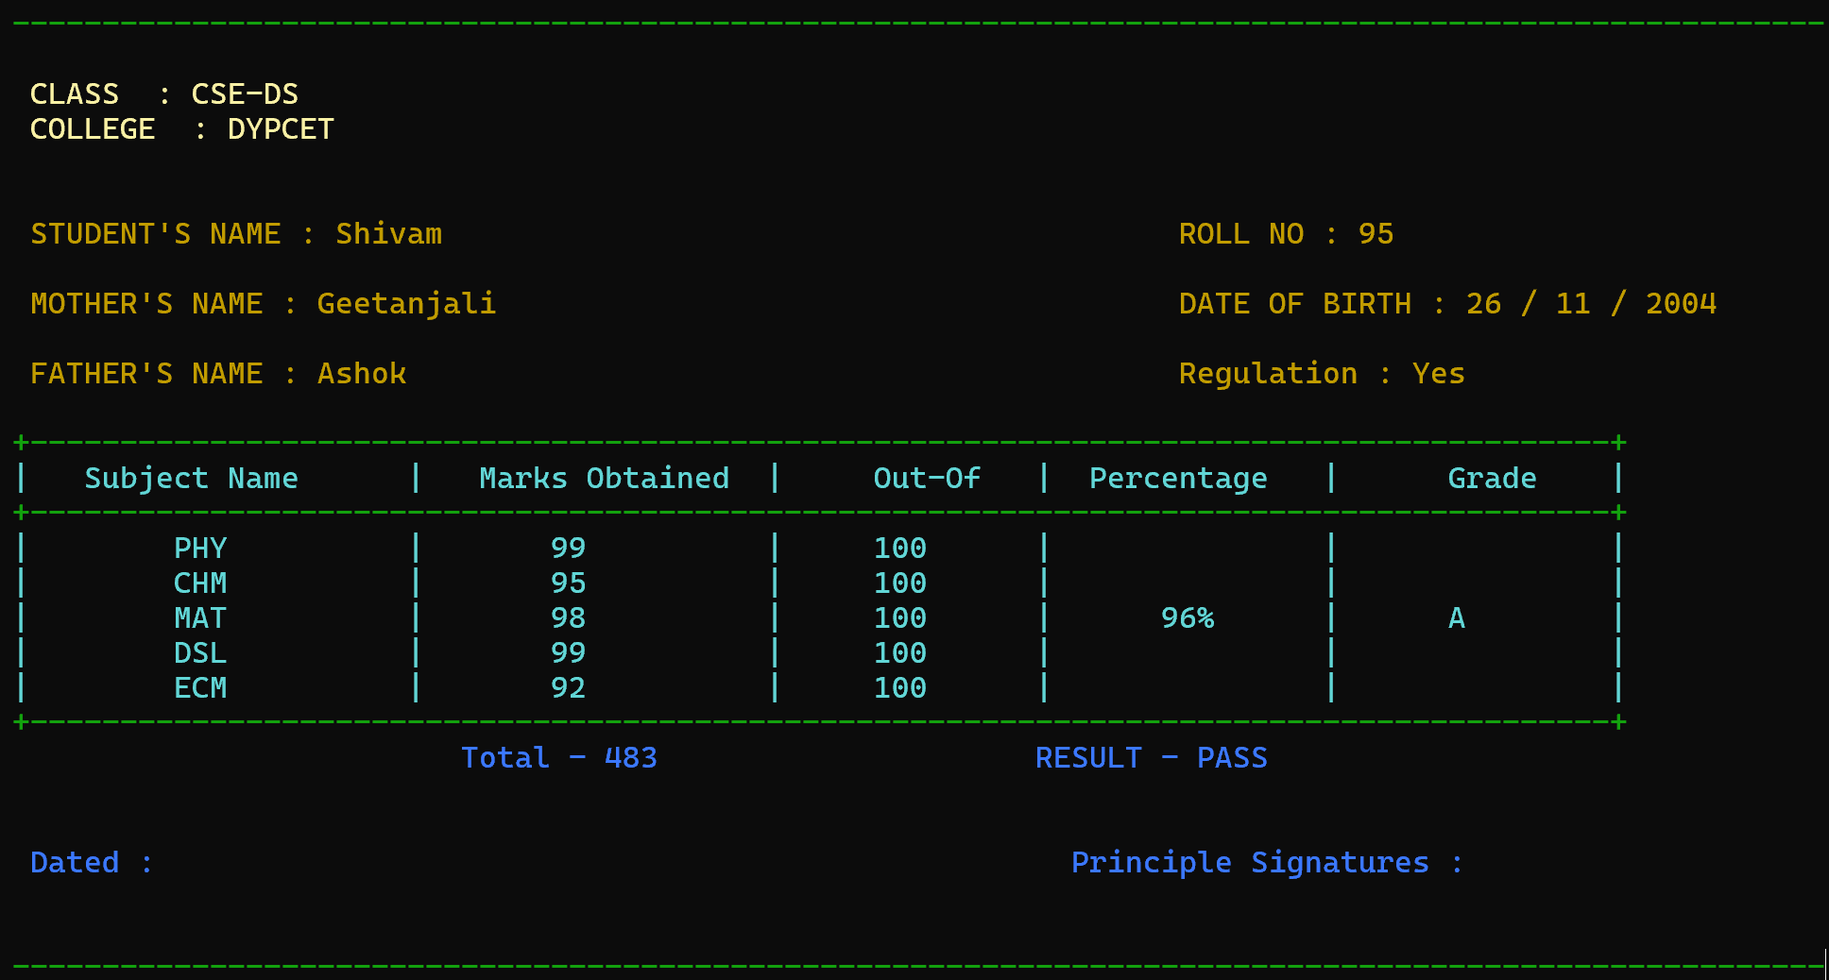
Result Sheet

Slide 15
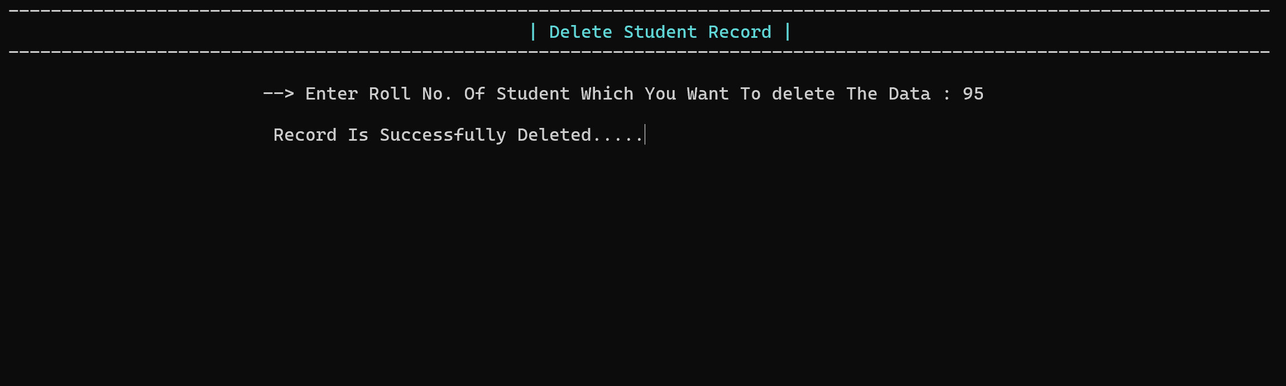
Deleting a record

Slide 16
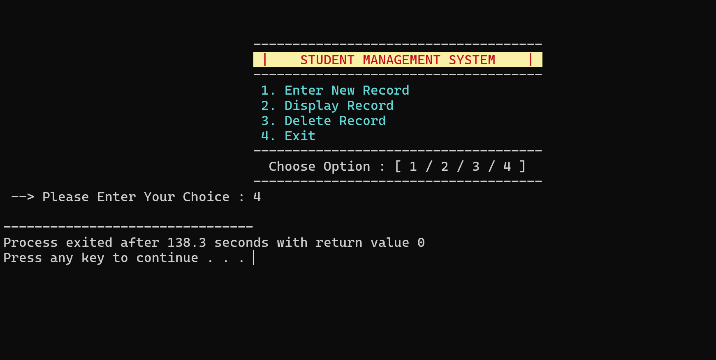
Exiting a program

Slide 17
COMPARISON OF PROPOSED SYSTEM WITH EXISTING SYSTEM
Aspect | Existing Manual System | Proposed System
Data Management | Manual, error-prone | Automated, error-free
Accessibility | Limited | Easily accessible
Efficiency | Time-consuming | Quick and efficient

Slide 18
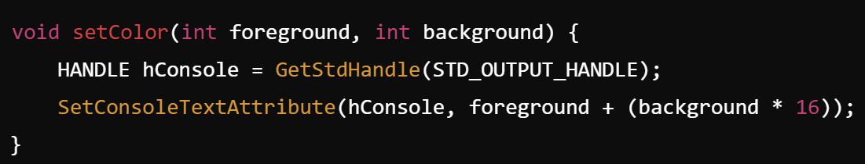
SetColor() Function in C++:
Purpose :
Used to change text and background colors in the console.
Enhances user experience by making output more readable and engaging.
Syntax :

Slide 19
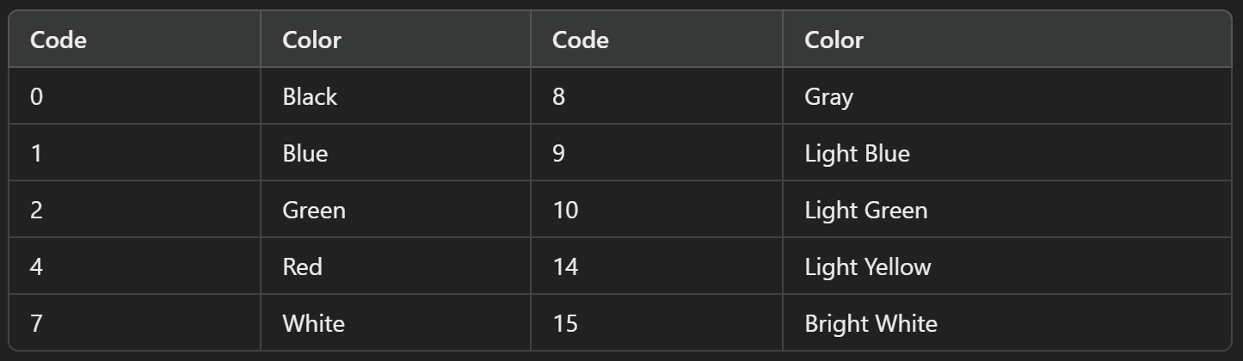
SetColor() Function in C++:
Parameters :-
foreground : Textcolor (0-15)
background : Background Color (0-15)
Color Codes :
Code | Color | Code | Color
0 | Black | 8 | Gray
1 | Blue | 9 | Light Blue
2 | Green | 10 | Light Green
4 | Red | 14 | Light Yellow

Slide 20

SetColor() Function in C++:
Key Points:
Works only on Windows OS.
Resets with setColor(7, 0) for White text and Black background .

Slide 21

CONCLUSION
A simple Student Management System using file handling.
Add, view, and delete student records easily.
Lightweight and easy to maintain for smaller schools.

Slide 22



IMPORTANCE:
Efficiently manages student data.
Advantages:
Simple and easy to use.
No need for a database.

Slide 23

FUTURE SCOPE
Future Enhancements:
Search Functionality to find students by name or roll number.
Database Integration for larger-scale usage.
Limitations:
Only basic operations (add, view, delete).
Console-based interface, may not be as user-friendly for larger systems.

Slide 24
REFERENCES
C++ Programming Documentation: Official C++ docs fora features and libraries.
File Handling in C++: Tutorials explaining file handling techniques.

Slide 25


THANKS!

